Slide 1
Object Oriented Programming and Design
Presented by
Dr Ramya Devi M
mramyadevi@wilp.bits-pilani.ac.in
CS - 10 : 27th Sep 2025

Slide 2

IMP Note to Self

Slide 3
Interface

Slide 4
Session plan
Designing the interfaces
Extending interfaces
Implementing interfaces
Using the Comparator and Comparable interfaces
Nested Classes and Nested Interfaces
Inheriting Nested Types
Inner Classes and Anonymous classes

Slide 5
Interfaces
A Java interface is a collection of abstract methods and constants
An abstract method is a method header without a method body
An abstract method can be declared using the modifier abstract, but because all methods in an interface are abstract, usually it is left off
An interface is used to establish a set of methods that a class will implement

Slide 6
Interfaces
interface is a reserved word
None of the methods in
an interface are given
a definition (body)
public interface Doable
{
public void doThis();
public int doThat();
public void doThis2 (float value, char ch);
public boolean doTheOther (int num);
}
A semicolon immediately
follows each method header

Slide 7
Interfaces
An interface cannot be instantiated
Methods in an interface have public visibility by default
A class formally implements an interface by:
  stating so in the class header
  providing implementations for each abstract method in the interface
If a class asserts that it implements an interface, it must define all methods in the interface

Slide 8
Interfaces
public class CanDo implements Doable
{
public void doThis ()
{
// whatever
}
public void doThat ()
{
// whatever
}
// etc.
}
implements is a
reserved word
Each method listed
in Doable is
given a definition

Slide 9
Example of an Interface in Java
This is how a class implements an interface. It has to provide the body of all the methods that are declared in interface or in other words we can say that class has to implement all the methods of interface.
interface in1
{
final float PI = 3.14f;
public void Amethod1();
public void Amethod2();
}
Object Oriented Programming

Slide 10
Example of an Interface in Java
class Sub implements in1
{ public void Amethod1()
{
System.out.prinltn(“\n It is Abstract Method 1 of Interface”);
}
public void Amethod2()
{
System.out.prinltn(“\n It is Abstract Method 2 of Interface”);
}
}
Object Oriented Programming

Slide 11
Example of an Interface in Java
class MyDemo
{
public static void main(String aa[])
{
Sub S = new S();
S.Amethod1();
S.Amethod2();
}
}
The output of the above program is
It is Abstract Method 1 of Interface
It is Abstract Method 2 of Interface
Object Oriented Programming

Slide 12
Interfaces
A class that implements an interface can implement other methods as well
In addition to (or instead of) abstract methods, an interface can contain constants
When a class implements an interface, it gains access to all its constants

Slide 13
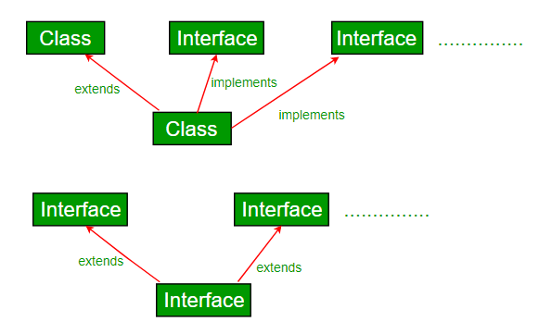
Interfaces
A class that implements an interface can implement other methods as well
In addition to (or instead of) abstract methods, an interface can contain constants
When a class implements an interface, it gains access to all its constants

Slide 14
Comparison with Inheritance
Interfaces don’t define any method actions… you need to fill in all the details
It essentially just gives a basic collection of method names
Not a strict hierarchy
Important: can implement several Interfaces
Can use this to “fake” multiple inheritance

Slide 15
Interfaces vs. Abstract Classes
Similarities
  neither can be instantiated
  both can be used as the starting point for a class
Differences
  A class can contain implementations of methods
  A class can implement many interfaces, but only one class

Slide 16
Comparison
In order of “abstractness”:
  Interface
    No method implementations
    Cannot be instantiated
  Abstract class
    Some method implementations
    Cannot be instantiated
  Non-abstract class
    All methods implemented can be instantiated

Slide 17
Interfaces
A class can implement multiple interfaces
The class must implement all methods in all interfaces listed in the header
class ManyThings implements interface1, interface2
{
// all methods of both interfaces
}

Slide 18
Key differences between abstract class and interface.
The table below lists out the key differences between abstract class and interface.
Parameter | Abstract Class | Interface
Default Method Implementation | It can have default method implementation | Interfaces provide pure abstraction & can not have implementation at all
Variables | It may contain non-final variables. | Variables declared in an interface are by default final
Keyword Used | An abstract class can be extended using the keyword “extends | The interface should be implemented using keyword implements
Object Oriented Programming

Slide 19
Key differences between abstract class and interface.
Access Modifiers | Can have public, protected, private and default modifier | Interface methods are by default public. you can not use any other access modifier with it
Speed of Implementation | It is faster than the interface | An Interface is somewhat slower & require extra indirection
Normal Class | It can extend only one abstract class | Can implement multiple interfaces
Constructors | An abstract class can have constructors | An interface can not have constructors
Multiple Inheritance | An abstract class can extend another class and can implement multiple Java interfaces | The interface can extend another Java interface only
Object Oriented Programming

Slide 20
INTERFACE - Example
Import java.util.*;
interface Shape
{
final float PI=3.1417f;
abstract void DisplayArea();
}
class Circle implements shape
{
float r,A;
public void DisplayArea()
{
Scanner S=new Scanner(System.in);
Object Oriented Programming

Slide 21
INTERFACE - Example
r=S.nextFloat();
A=PI*r*r;
System.out.prinltn(“Area of the Circle “+A);
}
}
class Rectangle implements shape
{
float l,b,A;
public void DisplayArea()
{
Scanner S=new Scanner(System.in);
l=S.nextFloat();
b=S.nextFloat();
Object Oriented Programming

Slide 22
INTERFACE - Example
A=l*r;
System.out.prinltn(“Area of the Rectangle “+A);
}
}
class Square implements shape
{
float a,A;
public void DisplayArea()
{
Scanner S=new Scanner(System.in);
a=S.nextFloat();
A=a*a;
System.out.prinltn(“Area of the Square“+A);
Object Oriented Programming

Slide 23
INTERFACE - Example
}
}
class DemoInterface
{
public static void main(String aa[])
{
Circle C = new Circle();
C.DisplayArea();
Square S = new Square();
S.DisplayArea();
Rectangle R = new Rectangle();
R.DisplayArea();
Object Oriented Programming

Slide 24
interface Drawable{
void draw();
}
//Implementation: by second user
class Rectangle implements Drawable{
public void draw(){System.out.println("drawing rectangle");}
}
class Circle implements Drawable{
public void draw(){System.out.println("drawing circle");}
}

Slide 25
//Using interface: by third user
class TestInterface1{
public static void main(String args[]){
Drawable d=new Circle();//In real scenario, object is provided by method e.g. getDrawable()
d.draw();
}}

Slide 26
INTERFACE - Example
In the above example,
Shape() is an interface consisting of an abstract method DisplayArea( ) and a final data member PI.
The Shape interface is implemented in the classes such as Circle, Rectangle and Square.
The body of DisplayArea() is implemented according to the formula used for finding the area for various shapes (Circle, Rectangle and Square).
Area Circle = PI * r * r [r-radius]
Area of Rectangle = l * b [ l-length and b-breadth]
and Area of Square = a * a [a is the side ]
Object Oriented Programming

Slide 27
INTERFACE-Key points
Here are the key points to remember about interfaces:
1) We can’t instantiate an interface in java. That means we cannot create the object of an interface
2) Interface provides full abstraction as none of its methods have body. On the other hand abstract class provides partial abstraction as it can have abstract and concrete(methods with body) methods both.
3) implements keyword is used by classes to implement an interface.
Object Oriented Programming

Slide 28
INTERFACE-Key points
4) While providing implementation in class of any method of an interface, it needs to be mentioned as public.
5) Class that implements any interface must implement all the methods of that interface, else the class should be declared abstract.
6) All the interface methods are by default abstract and public.
Object Oriented Programming

Slide 29
INTERFACE - Advantages
Advantages of using interfaces are as follows:
1. Without bothering about the implementation part, we can achieve the security of implementation
2. In java, multiple inheritance is not allowed, however we can use interface to make use of it as we can implement more than one interfaces.
Object Oriented Programming

Slide 30
Nested Interfaces
An interface can be declared a member of a class or another interface.
Such an interface is called a member interface or a nested interface.
A nested interface can be declared as public, private, or protected.
This differs from a top-level interface, which must either be declared as public or use the default access level
When a nested interface is used outside of its enclosing scope, it must be qualified by the name of the class or interface of which it is a member.
Thus, outside of the class or interface in which a nested interface is declared, its name must be fully qualified.

Slide 31
Nested Interfaces
//This class contains a member interface.
class A {
//this is a nested interface
public interface NestedIF {
boolean isNotNegative(int x);
}
}
//B implements the nested interface.
class B implements A.NestedIF {
public boolean isNotNegative(int x) {
return x < 0 ? false: true;
}
}
class NestedIFDemo {
public static void main(String args[]) {
//use a nested interface reference
A.NestedIF nif = new B();
if(nif.isNotNegative(10))
System.out.println("10 is not negative");
if(nif.isNotNegative(-12))
System.out.println("this won't be displayed");
}
}

Slide 32
Extend Interfaces
One interface can inherit another by use of the keyword extends. The syntax is the same as for inheriting classes.
When a class implements an interface that inherits another interface, it must provide implementations for all methods required by the interface inheritance chain.
//One interface can extend another.
interface A2 {
void meth1();
void meth2();
}
//B now includes meth1() and meth2() -- it adds meth3().
interface B2 extends A2 {
void meth3();
}

Slide 33
Extend Interfaces
//This class must implement all of A and B
class MyClass implements B2 {
public void meth1() {
System.out.println("Implement meth1().");
}
public void meth2() {
System.out.println("Implement meth2().");
}
public void meth3() {
System.out.println("Implement meth3().");
}
}
class IFExtend {
public static void main(String arg[]) {
MyClass ob = new MyClass();
ob.meth1();
ob.meth2();
ob.meth3();
}
}

Slide 34
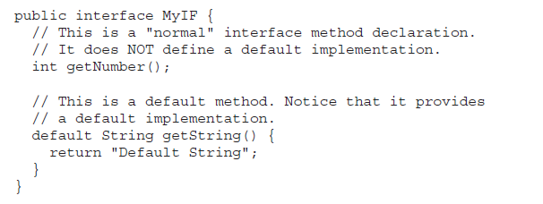
Default methods in interfaces
A default method lets you define a default implementation for an interface method.
In other words, by use of a default method, it is now possible for an interface method to provide a body, rather than being abstract.
A primary motivation for the default method was to provide a means by which interfaces could be expanded without breaking existing code.
Another motivation for the default method was the desire to specify methods in an interface that are, essentially, optional, depending on how the interface is used.

Slide 35
Default method
interface MyIF {
int getNumber(); // This is a "normal" interface method declaration.
default String getString() {
return "Default String"; } // This is a default method.
}
class MyIFImp implements MyIF {// Implement MyIF.
// Only getNumber() defined by MyIF needs to be implemented.
// getString() can be allowed to default.
public int getNumber() {
return 100;
}
}
class DefaultMethodDemo {
public static void main(String args[]) {
MyIFImp obj = new MyIFImp();
System.out.println(obj.getNumber());
// Can also call getString(), because of default
// implementation:
System.out.println(obj.getString());
}}
A default method lets you define a default implementation for an interface method.
In other words, by use of a default method, it is now possible for an interface method to provide a body, rather than being abstract.

Slide 36
Multiple Inheritance Issues
Assume that two interfaces called Alpha and Beta are implemented by a class called MyClass.
What happens if both Alpha and Beta provide a method called reset( ) for which both declare a default implementation?
Is the version by Alpha or the version by Beta used by MyClass?
Or, consider a situation in which Beta extends Alpha.
Which version of the default method is used?
Or, what if MyClass provides its own implementation of the method?

Slide 37
Multiple Inheritance Issues
A class implementation takes priority over an interface default implementation.
Second, in cases in which a class implements two interfaces that both have the same default method, but the class does not override that method, then an error will result.
In cases in which one interface inherits another, with both defining a common default method, the inheriting interface’s version of the method takes precedence.
It is possible to explicitly refer to a default implementation in an inherited interface by using a new form of super.
Its general form is shown here:
InterfaceName.super.methodName( )
For example, if Beta wants to refer to Alpha’s default for reset( ), it can use this statement: Alpha.super.reset();

Slide 38
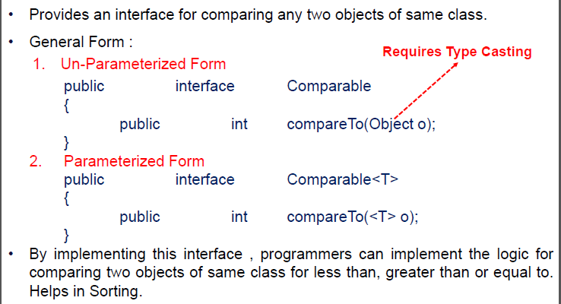
Comparable Interface
Cleanup needs to occur during normal and exceptional processing
Example: Close a file
FileReader reader = null;
try
{
reader = new FileReader(name);
...
}
finally
{
if (reader != null) reader.close();
}

Slide 39

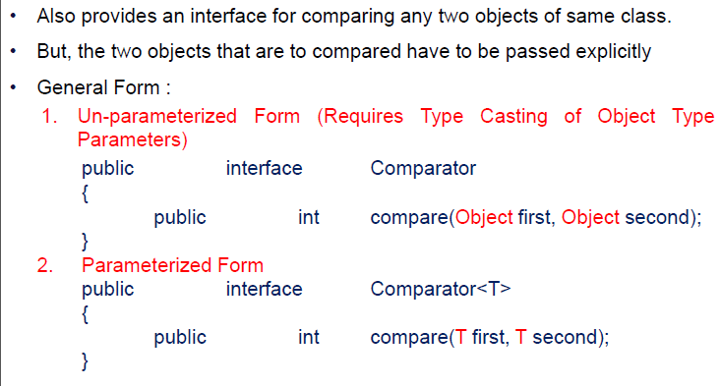
Comparable Interface
Cleanup needs to occur during normal and exceptional processing
Example: Close a file
FileReader reader = null;
try
{
reader = new FileReader(name);
...
}
finally
{
if (reader != null) reader.close();
}
More on Comparable and Comparator interfaces in Lab session 2

Slide 40
Java Nested Class
It is possible to define a class within another class; such classes are known as nested classes.
The scope of a nested class is bounded by the scope of its enclosing class.
Thus, if class B is defined within class A, then B does not exist independently of A.
A nested class has access to the members, including private members, of the class in which it is nested.
However, the enclosing class does not have access to the members of the nested class.
A nested class that is declared directly within its enclosing class scope is a member of its enclosing class.
It is also possible to declare a nested class that is local to a block.

Slide 41
Java Nested Class
In Java, just like methods, variables of a class too can have another class as its member.
Writing a class within another is allowed in Java.
The class written within is called the nested class, and the class that holds the inner class is called the outer class.
class Outer_Demo {
class Inner_Demo {
}
}

Slide 42
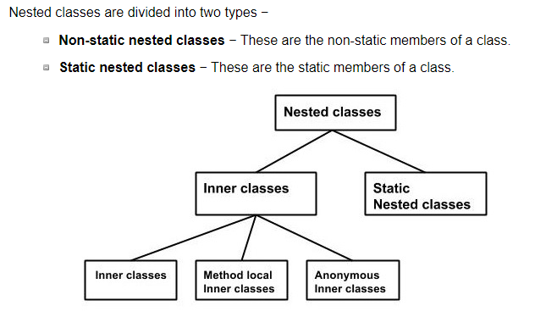
Java Nested Class
In Java, just like methods, variables of a class too can have another class as its member. Writing a class within another is allowed in Java. The class written within is called the nested class, and the class that holds the inner class is called the outer class.
class Outer_Demo {
class Inner_Demo {
}
}

Slide 43
Nested Classes, Local Classes, Anonymous Classes
When to Use Nested Classes, Local Classes, Anonymous Classes
Local class: Use it if you need to create more than one instance of a class, access its constructor, or introduce a new, named type (because, for example, you need to invoke additional methods later).
Anonymous class: Use it if you need to declare fields or additional methods.
Nested class: Use it if your requirements are similar to those of a local class, you want to make the type more widely available, and you don't require access to local variables or method parameters.
  Use a non-static nested class (or inner class) if you require access to an enclosing instance's non-public fields and methods. Use a static nested class if you don't require this access.

Slide 44
Thanks

